Slide 1
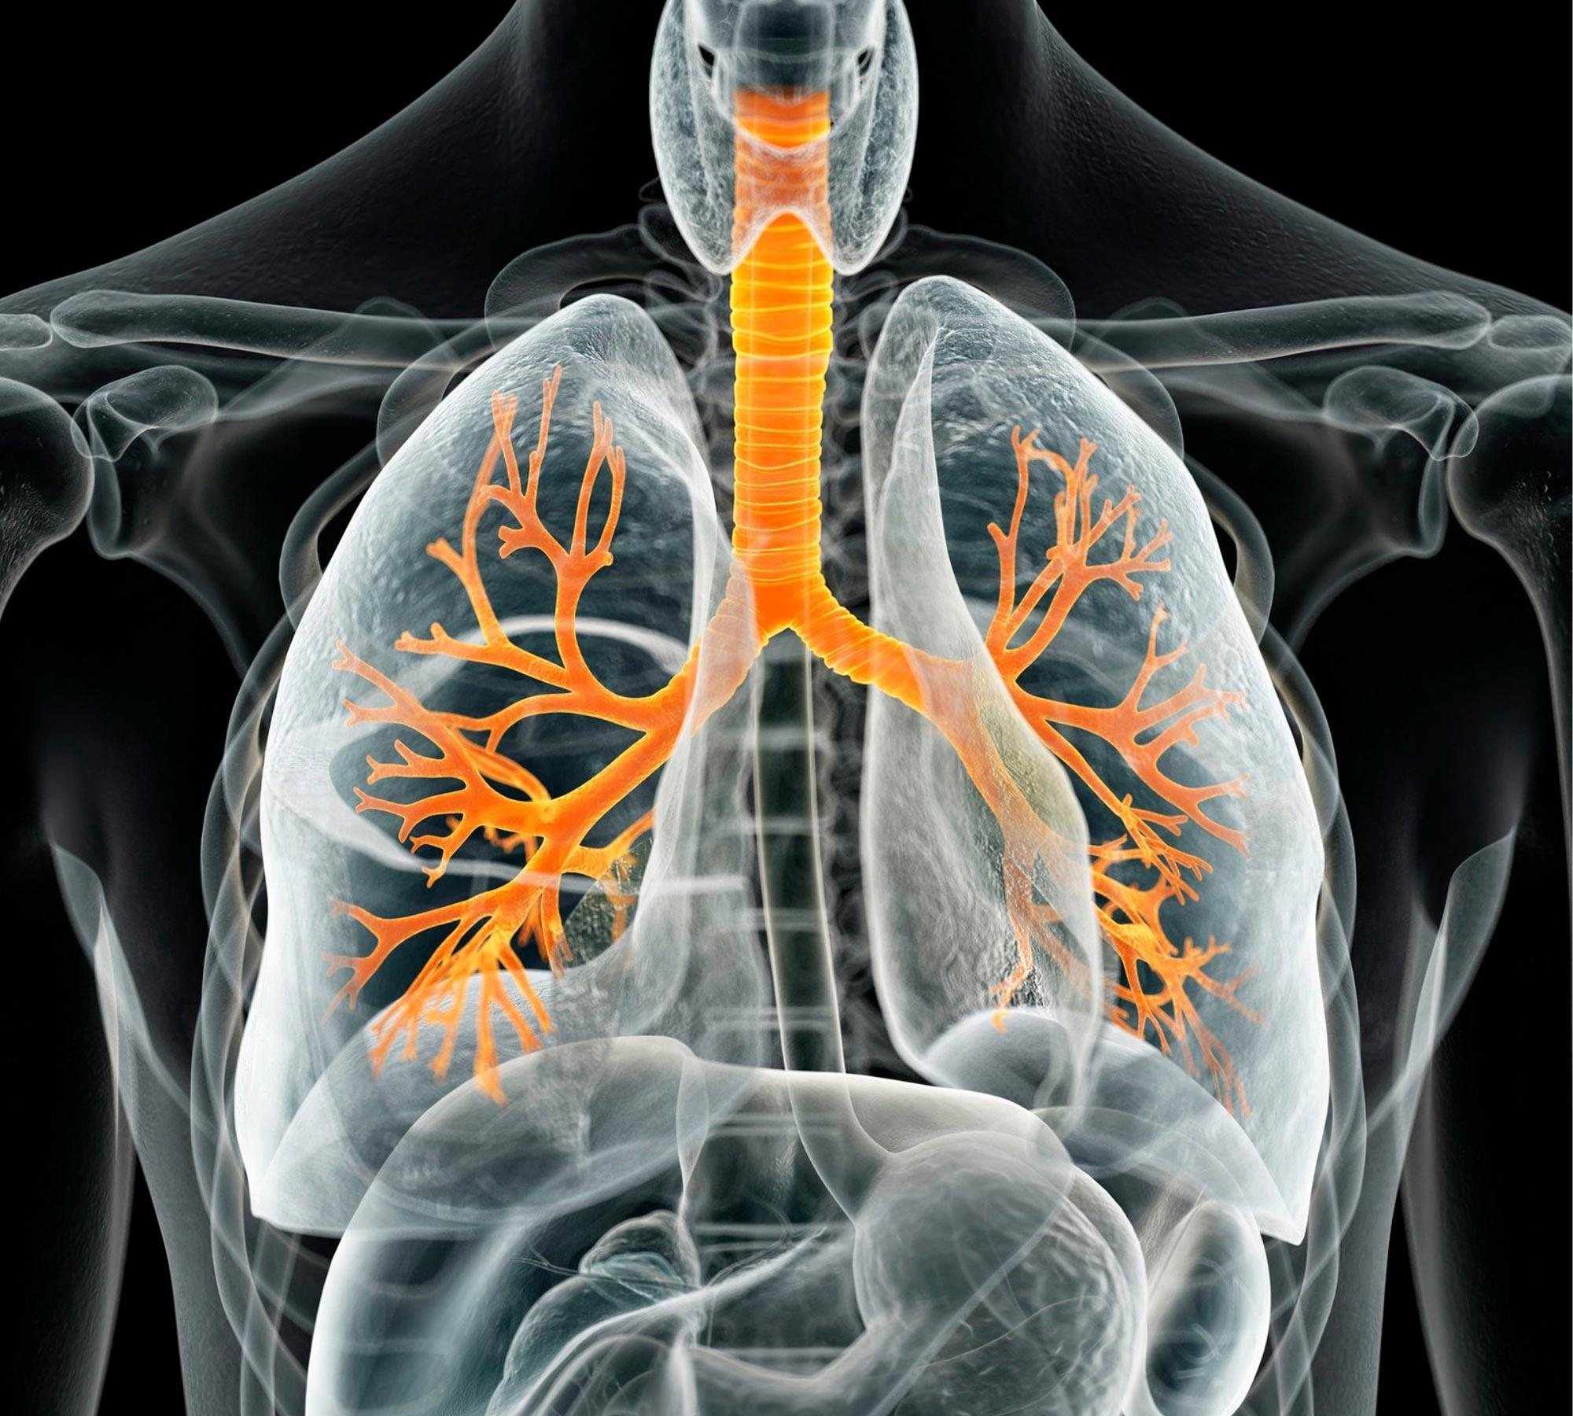
Medical Image Classification for Lung Cancer
Group 8: Boyu Liu, Dehan Cui, Manhui Zhu, Zeqi Zhou

Slide 2
PART 01
Background
CONTENTS
PART 02
Methodology
PART 03
Result
PART 04
Conclusion

Slide 3
PART 01
Problem Background
Lung Cancer & Diagnosis

Slide 4
Background
Early Diagnosis:
Nationally, only 24% of cases are diagnosed at an early stage when the five-year survival rate is much higher (60%). Unfortunately, 46% of cases are not caught until a late stage when the survival rate is only 6%
Survival Rate:
The national average of people alive five years after a lung cancer diagnosis is 23.7% .
Notes:
Improve the screening rate, encourage people to do the routine physical check-up every year.
radiologist: training, practice, over 10 years schooling and experience
improve efficiency of diagnosis, alleviate the shortage of radiologist, and meet the market demand, increase the survival chances for patients.

Slide 5
PART 02
Methodology
VGG16, Inception V3, ResNet, Curriculum Learning

Slide 6
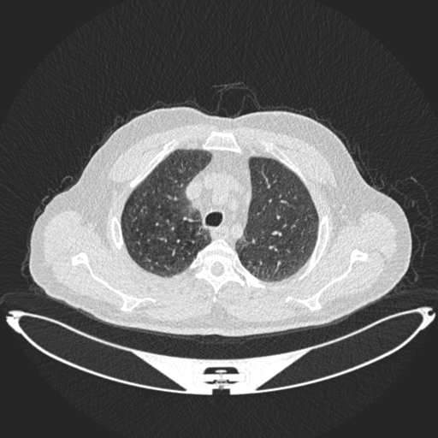
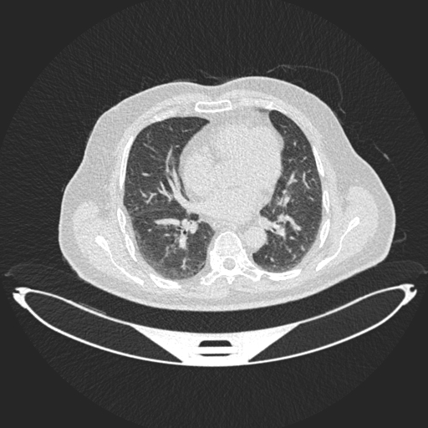
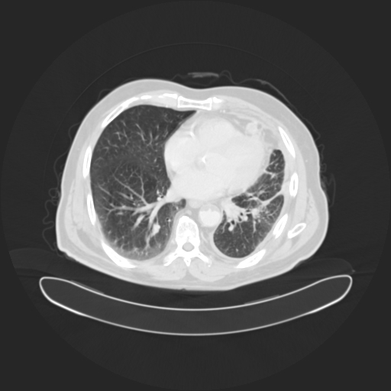
Dataset
Normal Case
Case example
The data is from the Iraq-Oncology Teaching Hospital/National Center for Cancer Diseases (IQ-OTH/NCCD) lung cancer dataset.
Sample space: 110 patients, grouped into three categories: 55 normal cases, 15 benign cases, 40 malignant cases.
Benign Case
For each case, about 10 representing CT scan slices of human chest with different sides and angles are selected from the CT image sequence. In total, it provides 1097 CT scans.
In our project: we split the dataset into a training set (70%), a testing set (20%), and a validation set(10%).
Malignant Case

Slide 7
VGG 16
A CNN which is able to classify 1000 images of 1000 different categories with 92.7% accuracy.
The 16 refers to 16 weighted (learnable parameter) layers. There are 13 convolutional layers, 5 max pooling layers, and 3 dense layers which sum up to 21 layers
It is created by Karen Simonyan and Andrew Zisserman and wins ImageNet Large-Scale Visual Recognition Challenge (ILSVRC) in 2014. (link of original paper: 1409.1556.pdf (arxiv.org)

Slide 8
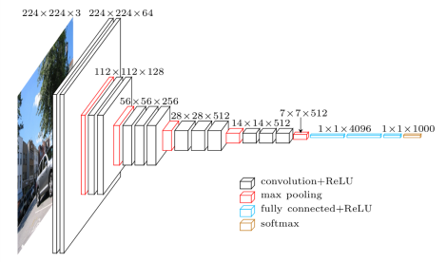
VGG 16

Slide 9
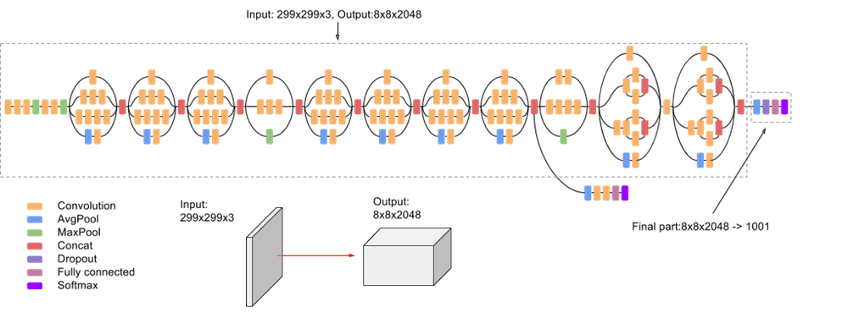
Inception V3
Notes:
The inception V3 (released in 2015) is a superior version of the basic model Inception V1 which was introduced as GoogLeNet in 2014.
When using multiple deep layers of convolutions in a model, it will result in the overfitting of the data. To avoid this problem, the inception model using multiple filters of different sizes on the same level.
Instead of having deep layers, inception models have parallel layers, thus making the model wider rather than making it deeper.
Inception V3: CNN has 42 layers in total.

Slide 10
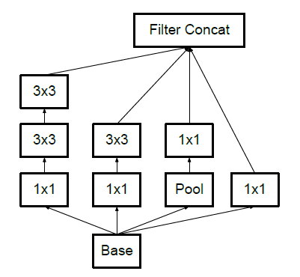
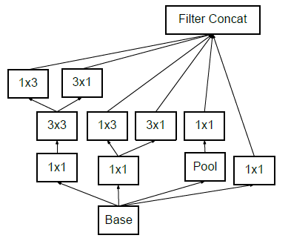
Inception V3
Factorization into Smaller Convolutions: the 5*5 convolutional layers was replaced by two 3*3 convolutional layers, which reduce the computational cost.
Spatial factorization into asymmetric convolutions：asymmetric convolutions are of form n*1.
Notes:
Compared to V1, V3 is: higher efficiency, has a deeper network compared to the Inception V1 and V2 models, but its speed isn’t compromised. it’s computationally less expensive.
1*1 convolutional layers: initial inception model is computationally expensive, time-consuming and requires high computational power. This results in reduced dimensions of the networks and faster computations.
A better alternative to make the model more efficient.
Asymmetric convolutions: replace the 3*3 convolutions with a 1*3 convolution followed by a 3*1 convolution.

Slide 11
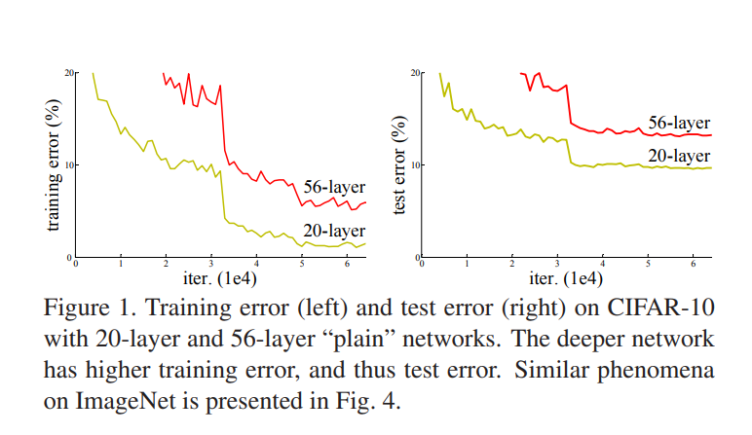
ResNet (Deep Residual Network)
Is learning better networks as easy as stacking more layers?
NO!
The degradation problem:
with the network depth increasing, accuracy gets saturated, and then degrades rapidly.

Slide 12
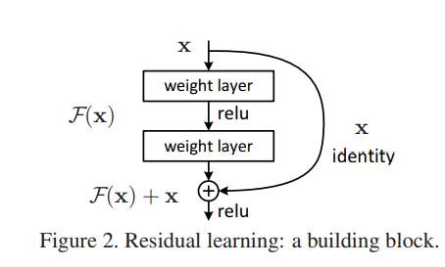
ResNet (Deep Residual Network)
Let H(x) be an underlying mapping to be fit by a few stacked layers
Residual Learning:
Explicitly let these layers approximate a residual function F(x) := H(x) − x. The original function thus becomes F(x)+x.
Shortcut connection:
Perform identity mapping, and their outputs are added to the outputs of the stacked layers
Through this technique, ResNet models with deep layers have less training and testing error than “plain” deep networks!

Slide 13
Curriculum Learning
Mimics the design of curriculum for human students:
(i) Arrange the material in a way that reflects difficulty
(ii) Attend to the pace by which the material is presented
Attempts at imposing some structure on the training set
The structure relies on the notion of “easy” and “hard” examples
Two key components:
Scoring Function: Sorts the training examples by difficulty
Pacing Function: Determines the pace by which data is presented to the networks

Slide 14
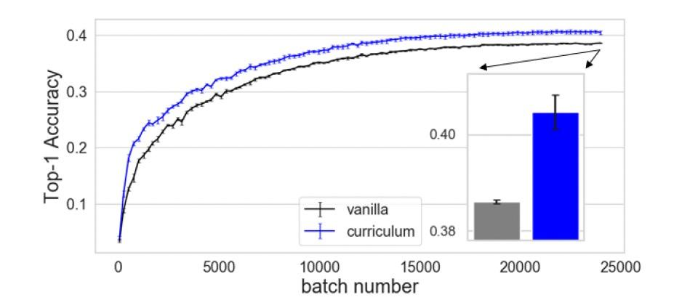
Curriculum Learning
CIFAR-100 dataset

Slide 15
PART 03
Result

Slide 16
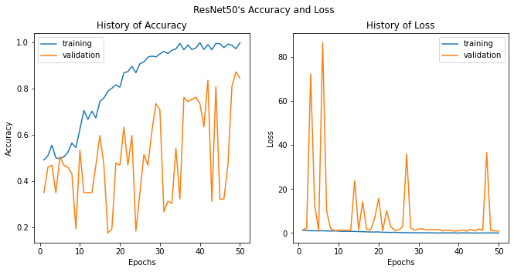
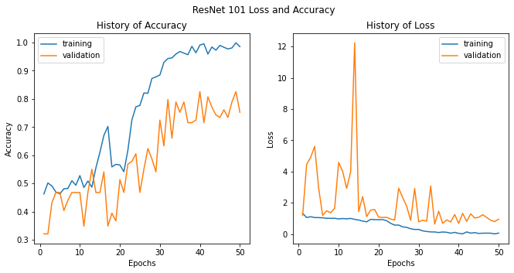
Result

Slide 17
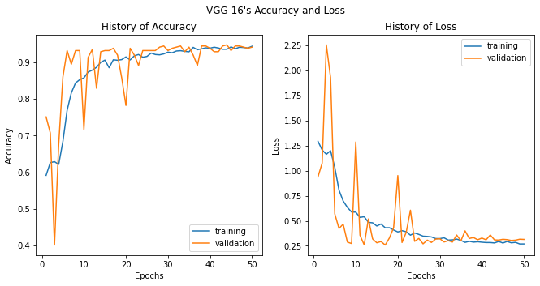
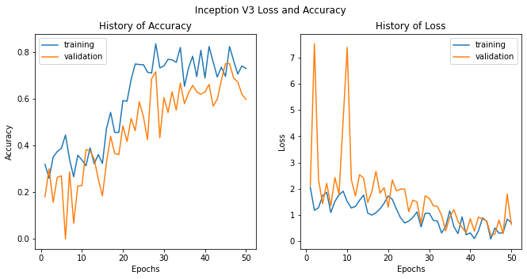
Result

Slide 18
Result
Method | Loss | Accuracy
Inception V3 | 2.0109 | 66.21%
VGG16 | 0.4781 | 87.78%
ResNet 50 | 1.3008 | 82.49%
ResNet 101 | 0.7150 | 82.69%

Slide 19
PART 04
Conclusion

Slide 20
Conclusion
Three deep convolutional networks, VGG16, Resnet, and Inception V3 are trained by the IQ-OTHNCCD dataset.
Networks
Curriculum learning algorithm is constructed to improve the networks trained in stage one.
Improvements
Experiments on the respiratory dataset of The IQ-OTHNCCD show that the method can classify lung cancer more accurately.
Result

Slide 21
Future Work
Adaptability
Accuracy
Multifunction
The model should be capable of processing various types of medical images.
Current model can be improved with accuracy
The model should be able to classify cancer based on stages and types of tumor and locate it.

Slide 22
Reference
State of Lung Cancer 2021 Report. American Lung Association. 2021
Kaiming He, Xiangyu Zhang, Shaoqing Ren, & Jian Sun. (2015). Deep Residual Learning for Image Recognition. Cornell University - ArXiv. https://doi.org/10.48550/arxiv.1512.03385
Christian Szegedy, Vincent Vanhoucke, Sergey Ioffe, Jonathon Shlens, & Zbigniew Wojna. (2015a). Rethinking the Inception Architecture for Computer Vision. ArXiv: Computer Vision and Pattern Recognition. https://arxiv.org/pdf/1512.00567.pdf
Guy Hacohen, & Daphna Weinshall. (2019). On The Power of Curriculum Learning in Training Deep Networks. International Conference on Machine Learning, 2535–2544.
Karen Simonyan, & Andrew Zisserman. (2014). Very Deep Convolutional Networks for Large-Scale Image Recognition. Computer Vision and Pattern Recognition.

Slide 23
Thanks For Listening
Group 8: Boyu Liu, Dehan Cui, Manhui Zhu, Zeqi Zhou

